Slide 1
RA 505 Robot Sensing and Vision Lecture 33
Dr. Rishikesh Kulkarni
Department of Electronics and Electrical Engineering
IIT Guwahati

Slide 2
Resistance Strain Gauge
Wire strain gauges
unbounded resistance wire strain gauges
Bonded resistance wire strain gauges.
Fine wire: about 25 um or less
Carrier: thin sheet of paper.
the carrier mounting of wire structure and carrier adhesion on the object surface plays a crucial role in strain measurement accuracy

Slide 3
Resistance Strain Gauge
Resistance of a conductor
change in resistance due to the change in dimension and change is fundamental property of the material (piezoresistance)
Strain
Poisson ratio:

Slide 4
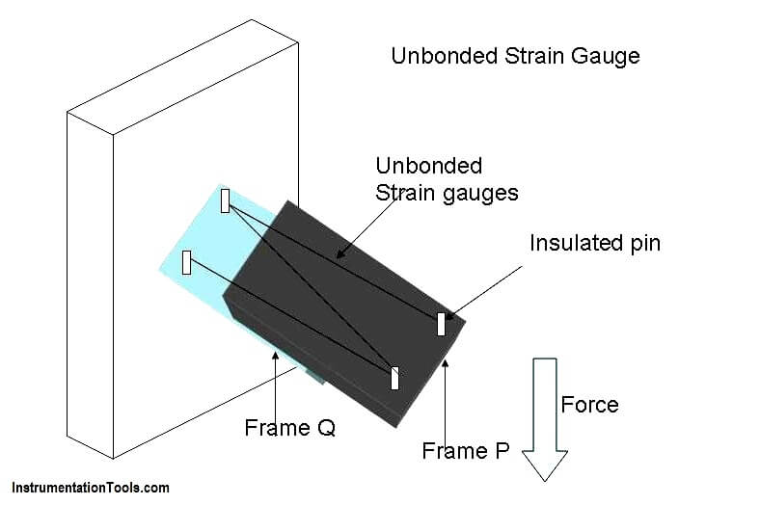
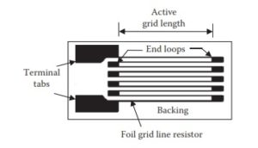
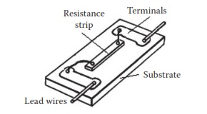
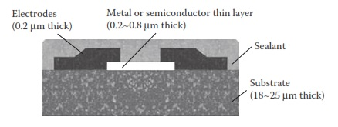
Resistance Strain Gauge
Unbounded metal-wire gage
Bonded metal-wire gage
Bonded metal-foil gage
Vacuum-deposited thin-metal-film gage
Sputter-deposited thin-metal-film gage
Bonded semiconductor gage
Diffused semiconductor gage

Slide 5
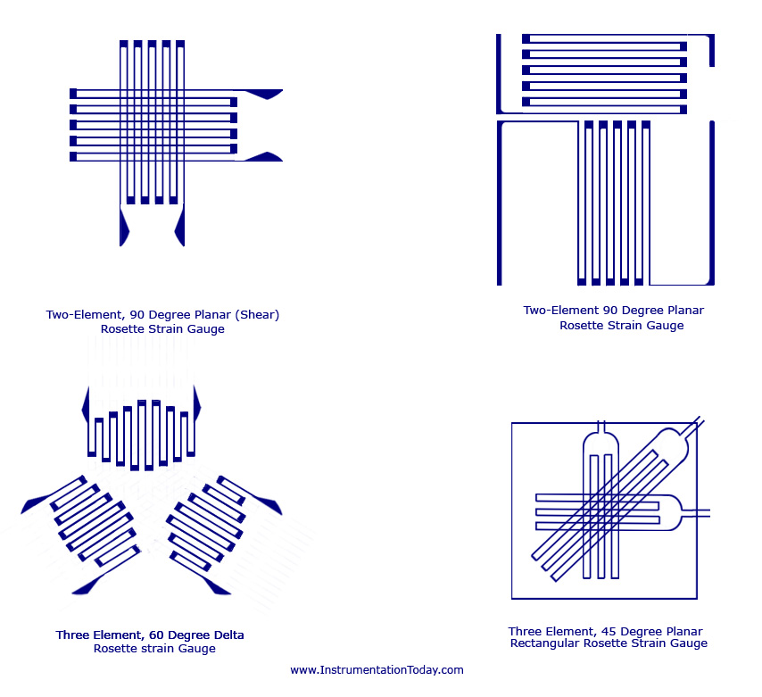
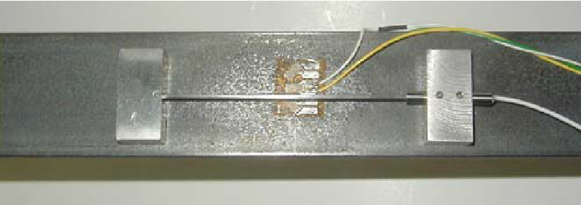
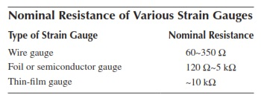
Resistance Strain Gauge
Bonded metal foil strain gauges
Copper-Nickel, Nickel-Iron alloys;
Thin metal grid mounted on flexible or brittle carrier;
measurement of average strain over an area;
Types of gauges are: Grid, Rossette, Torque and Helical.
The area is comparatively more than the wire strain
The resistive film thickness is typically 0.2mm thick.

Slide 6
Resistance Strain Gauge
Rosette are nothing but three strain gauges overlapping at a same point manufactured on the same carrier material.
Rosettes are used for the measurement of force, velocity, pressure and displacement in applications such as aircraft and missile production, mechanical engineering, railroad, car manufacturing and other industries.

Slide 7
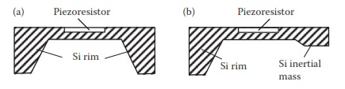
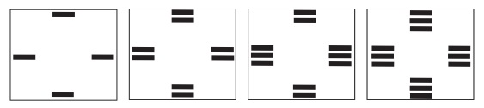
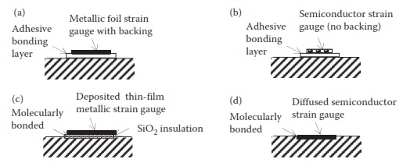
Supporting Structure And Bonding Methods Of Strain Gauges
Membrane-type and cantilever type
Bonding methods for strain gauge
adhesive bonding with backing,
adhesive bonding without backing,
deposited molecular bonding, and
diffused molecular bonding.

Slide 8
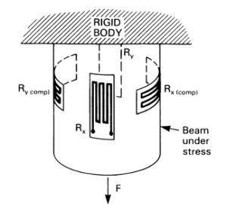
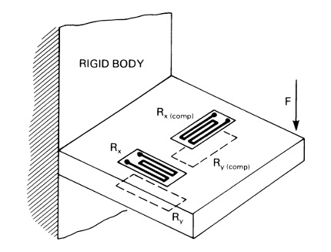
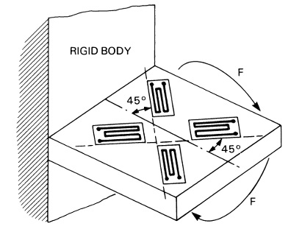
Placement of strain gauges

Slide 9
Resistance Measurement of Strain Gauge

Slide 10
Resistance Strain Gauge

Slide 11
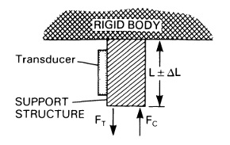

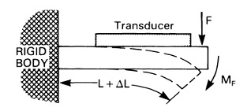
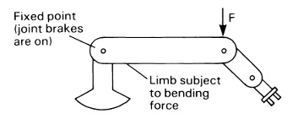
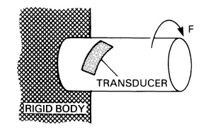
Force sensors
Kinematic forces
Static forces
choice and shape of the support material
long-term stability
Adhesion
Traction force: limbs of the robot in the vertical position
Bending force: a robot limb in a non-vertical position
Twisting force: drive shaft of a robot actuator

